Slide 1
Assessing LLMs' Reading Comprehension Question Generation Capabilities
Yoshee Jain
yosheej2@illinois.edu

Slide 2
Potential Research Questions
Can LLMs simulate human learners in a test-taking environment?
Can LLMs generate questions effectively testing various reading comprehension abilities for learners?
1

Slide 3
Overview of Methodology
Identify a reading comprehension framework that breaks down ‘reading comprehension’ into finite grained skills for assessment.
Identify questions that tests each of the skills in the reading comprehension framework.
Make the LLM complete the assessment. Record its accuracy and compare the results to results of the assessment from the target audience.
Make the LLM generate questions for each skill.
Again, have the LLM take an assessment (using questions it generated), record its results, and analyze in comparison to previous assessment results.
2

Slide 4
Reading Comprehension Framework
For this project, we are focussing on the Study Aid and Reading Assessment (SARA) [1] framework.
It contains six subtests, each of which targets a specific component of reading affecting a student's reading comprehension proficiency.
For this project, we are focusing on five subtests detailed in the next few slides.
[1] https://onlinelibrary.wiley.com/doi/10.1002/ets2.12269
3

Slide 5
Subtest 1: Word Recognition and Decoding
Word Recognition: Ability to identify real words in a language
Word Decoding: Ability of sounding out novel words that the reader has never or rarely seen before and identifying if it sounds like a real word or not. It is sometimes also referred as phonological decoding.
Examples:
Item text: kare
Response options:
Is a real word
Is NOT a real word
Sounds EXACTLY like a real word
Correct answer: Sounds EXACTLY like a real word
Item text: water
Response options:
Is a real word
Is NOT a real word
Sounds EXACTLY like a real word
Correct answer: Is a real word
Item text: dut
Response options:
Is a real word
Is NOT a real word
Sounds EXACTLY like a real word
Correct answer: Is NOT a real word
4
[1] https://onlinelibrary.wiley.com/doi/10.1002/ets2.12269

Slide 6
Subtest 2: Vocabulary
Ability of determining the meanings of presented words.
Ability of identifying the synonyms of the presented words from the given choices.
Item text: stone
Response options:
jump
rock
cat
Correct answer: rock
Example:
[1] https://onlinelibrary.wiley.com/doi/10.1002/ets2.12269
5

Slide 7
Subtest 3: Morphology
Ability to recognize and understand the role of morphemes in words and complete sentences.
Morphemes: Smallest parts of a word that carry meaning usually consisting of the root (happy) and prefixes/suffixes (...ing, …er, etc.)
in the word "unhappiness," there are three morphemes:
"un-" (which means "not"),
"happy" (which means "feeling good")
"-ness" (which turns the adjective "happy" into a noun)
Example:
Item text: The ______ began class.
Response options:
teaching
teacher
teaches
Correct answer: teacher
[1] https://onlinelibrary.wiley.com/doi/10.1002/ets2.12269
6

Slide 8
Subtest 4: Sentence Processing
Ability to construct basic meaning from print at the sentence level.
Item text: The person ate __________ pieces of bread.
Response options:
many
soon
far
Correct answer: many
Example:
7
[1] https://onlinelibrary.wiley.com/doi/10.1002/ets2.12269

Slide 9
Subtest 6: Reading Comprehension
Ability to read and understand text from a passage and answer related questions.
Passage about Development of Subways
…. Most people support subway systems because they reduce car traffic and air pollution. But building and maintaining a subway system can be very expensive. …..
Item text: According to the passage, subway systems:
Response options:
first appeared in New York
can be expensive to maintain
fail when they don’t offer enough stops
Correct answer: can be expensive to maintain
Example:
[1] https://onlinelibrary.wiley.com/doi/10.1002/ets2.12269
8

Slide 10
RQ1: Can LLMs simulate human learners in a test-taking environment
Dataset with questions and their answers
Using a few-shot prompting approach to make the LLM take the assessment.
  Given a skill and a few examples of questions with their answers
  Task is to answer the rest of the questions
The assessment was repeated thrice to ensure greater accuracy and generalizability of results.
After data collection, we record overall accuracy and accuracy specific to each skill.
We will then compare this data to actual student data at different levels, e.g. middle school, high school, undergraduates, etc.
9

Slide 11
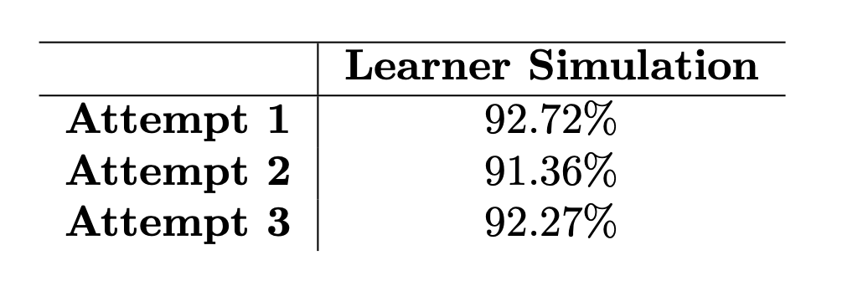
Preliminary Results of RQ1
Average accuracy of about 90%
The LLM may be able to simulate advanced learners at the undergraduate level based on the human test results.
10

Slide 12
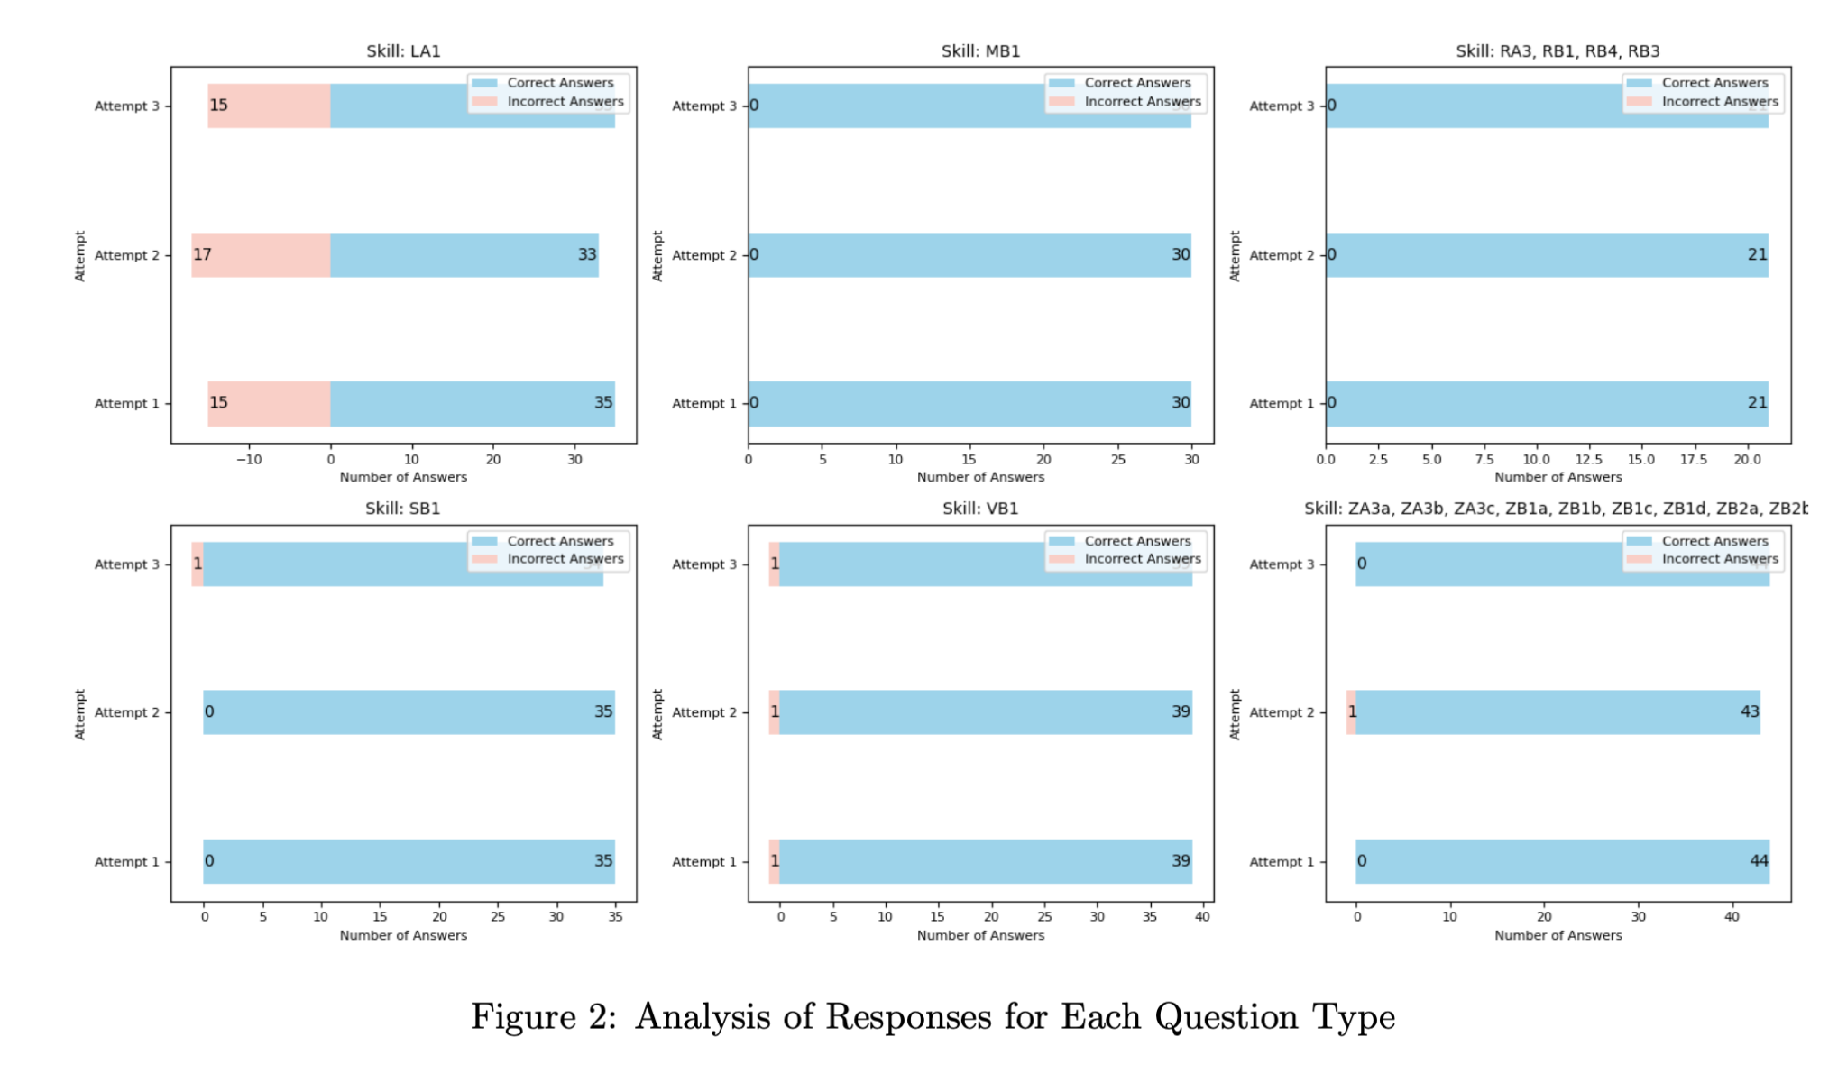
Performs poorly with word recognition and decoding tasks.
Mirrors current struggles with phonetic tasks.
11

Slide 13
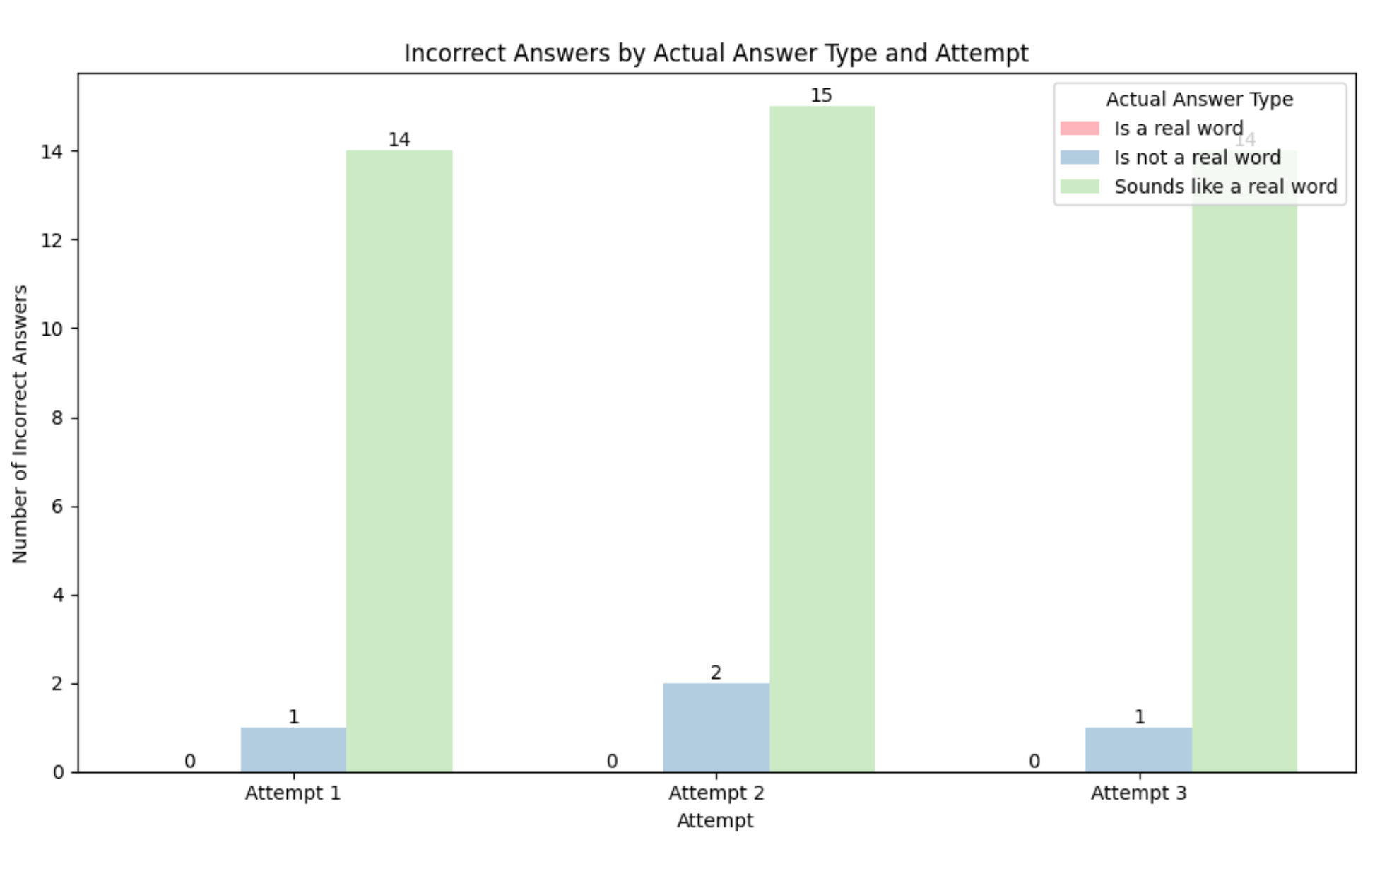
Preliminary Results of RQ1
Produces most incorrect answers while determining if the word is phonetically similar to existing words.
Specifically, it performs well with word recognition but poorly with word decoding
12

Slide 14
RQ2: Can LLMs generate questions effectively testing various reading comprehension abilities for learners?
Using a few-shot prompting approach, make the LLM generate 20 questions for every skill.
  Examples of questions with their answer is given for few-shot.
Make the LLM answer it’s generated questions in a separate chat.
Repeat thrice for validity.
Record accuracy and compare to the results of RQ1.
  If 90% accuracy was indicative of undergraduate student expertise, >90% accuracy would mean easier question-level and <90% would mean more difficult questions.
13

Slide 15
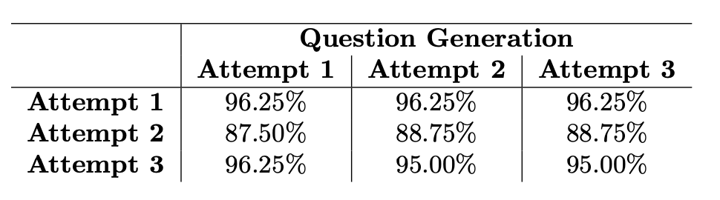
Preliminary Results of RQ2
In attempts 1 and 3, it generated questions easier than the undergraduate student level.
In attempt 2, it generate questions for a higher expertise than college students.
14

Slide 16
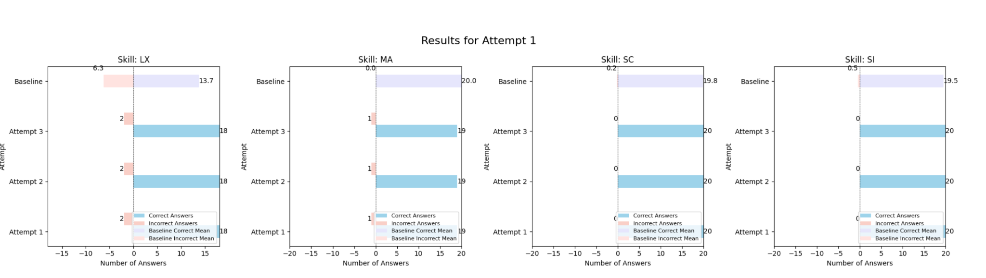
Preliminary Results of RQ2
Generates easier questions for the word decoding skill.
15

Slide 17
Future Work
Use more robust methods of analysis for evaluating question quality
  Classifiers
  Using linguistic metrics like readability, comprehensibility, quality of distractors, etc. from coh-metrix.
Build a cross-comparison analysis with other LLMs to ensure generalizability of results to all large language models.
16

Slide 18
Thank you to Jionghao Lin, Liang Zhang, and John Hollander for their feedback!

